Slide 1
DOCUMENT
VERIFIER

Slide 2


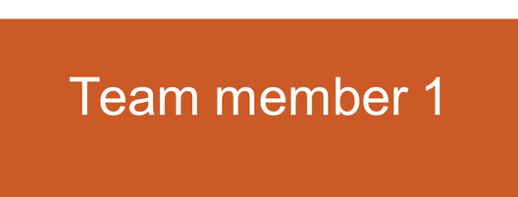




Team details
Team leader
Team member 2
Team member 3
Mayank Pancholi
Jatin Singh
Hrishita Bhatt
Mansi Bajeli

Slide 3




Problem Statement
Legal documents are vulnerable to tampering, forgery, and unauthorized changes.
Traditional verification methods are manual, time-consuming, and lack transparency.
There is a need for a secure, efficient system to verify document integrity

Slide 4


Methodology Used
Hashing – File is hashed using SHA-256.
Blockchain – Hash stored in blockchain with previous hash.
Flask App – Used for backend.
HTML,CSS-Used for frontend

Slide 5

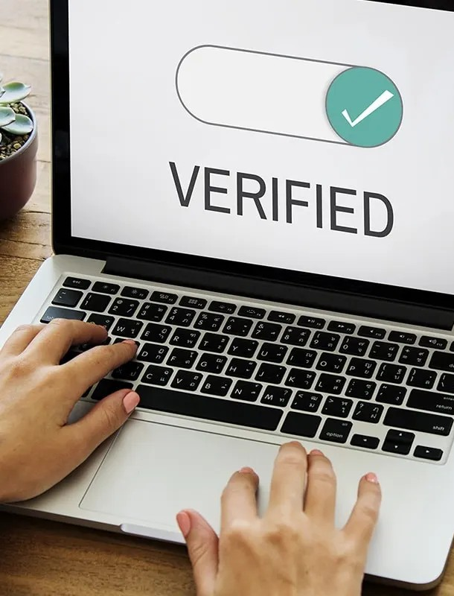
Working
User uploads a legal document through the web interface.
SHA-256 hash is generated for the uploaded file.
New block is created with file name, file hash, and previous hash.
Block is added to the blockchain and saved in a JSON file.
For verification, a file is uploaded and its hash is compared with the
blockchain.
If matched, the document is valid; otherwise, it's not found.

Slide 6


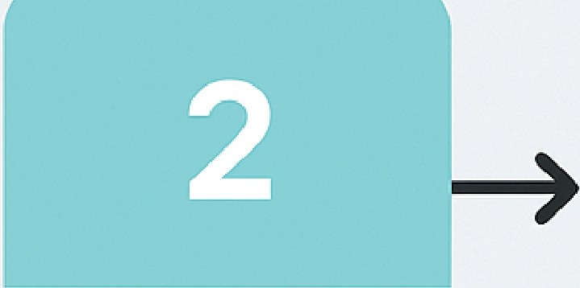
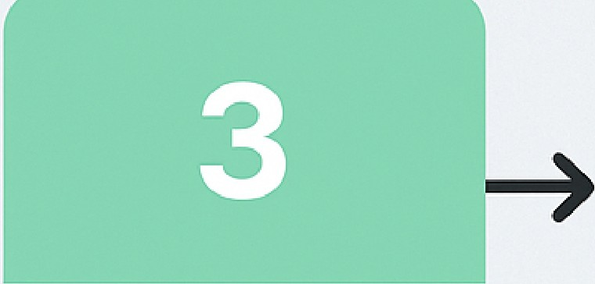

WORKING OF THE LEGAL DOCUMENT INTEGRITY VERIFFIER
User | SHA-256 | New block | File hash
uploads document | hash created | added to blockchain | verified

Slide 7

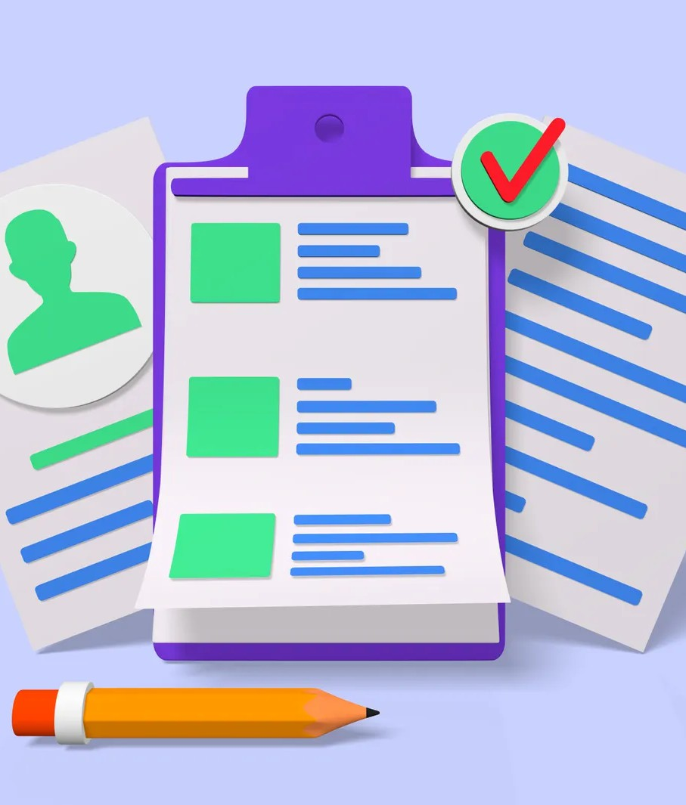
Future Scope
1-Integration with IPFS: Storing documents on InterPlanetary File System (IPFS) for decentralized and secure storage.
2-User Authentication System: Adding login/signup functionality for better user access control and history tracking.

Slide 8


